Slide 1
Presidential election campaign finances
Dan Edie, Megan Chang, & Nicholas Prentkowski

Slide 2
introduction
Initial questions
sources
How much are candidates spending on elections?
Do candidates spending the most money get more votes?
Are the most populous states contributing the most money?
Federal Election Commission's API
Pull data on campaign receipts
MIT's Election Lab database
Number of votes each candidate received

Slide 3
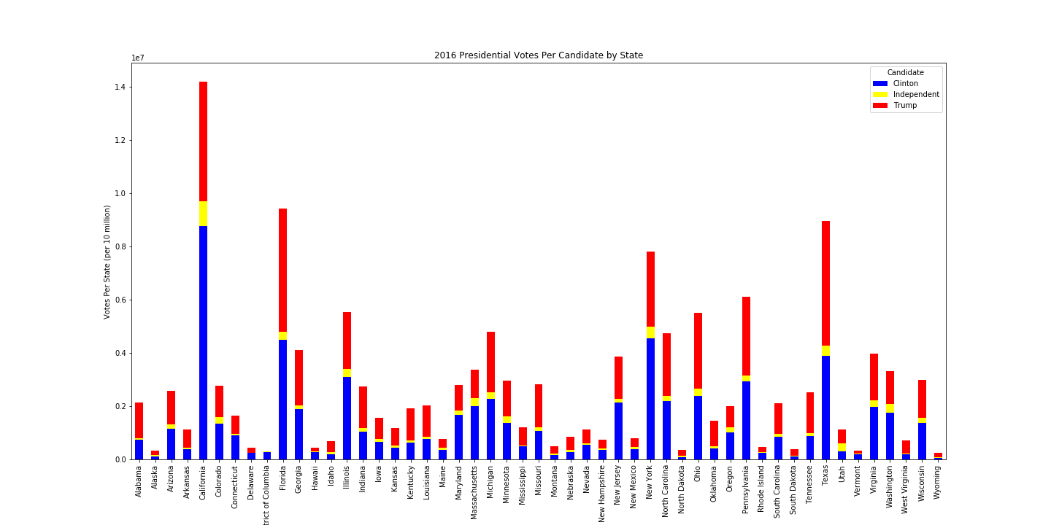
Clinton had the most votes in more populous states (California & New York).
Trump had the most votes in southern states.
Key states from the electoral college also voted majority Trump.

Slide 5
Total amount raised in 2016: $1,462,300,000
Money raised by democrats matches how long they actively campaigned
Republicans not so much: Kasich was last to drop before convention

Slide 6
Current amount raised: $2,476,100,000
Billionaires have blown the 2016 numbers out of the water
Bloomberg has raised $1,049,400,000 (~42%)
amount of money doesn’t always mean nomination

Slide 7
Democrats have raised more money than all of 2016
Nearly half the bar is due to one candidate
However, right now, not much campaigning is happening

